Slide 1
Chapter 3: Processes

Slide 2
Chapter 3: Processes
Process Concept
Process Scheduling
Operations on Processes
Interprocess Communication
IPC in Shared-Memory Systems
IPC in Message-Passing Systems
Examples of IPC Systems
Communication in Client-Server Systems

Slide 3
AGENDA
Identify the separate components of a process and illustrate how they are represented and scheduled in an operating system.
Describe how processes are created and terminated in an operating system, including developing programs using the appropriate system calls that perform these operations.
Describe and contrast interprocess communication using shared memory and message passing.
Design programs that uses pipes and POSIX shared memory to perform interprocess communication.
Describe client-server communication using sockets and remote procedure calls.
Design kernel modules that interact with the Linux operating system.

Slide 4
Recap
OS structures (Simple, monolithic, multikernel, layered, microkernel,)
UNIX/LINUX environment, file/directory structures, important directories (bin, dev, usr, lib, root, ~, ., .., $HOME)
Important commands (ls, pwd, cd, cp, mkdir, mv, rm, gcc)
Absolute versus relative path
Process concept (text/code, PC/CPU state, stack, data section, heap, PCB, environment)
PCB (PID, PPID, Process status, CPU state, Memory status, accounting info, CPU scheduling, I/O status)
Process status (new, ready, wait, run, exit)
CPU Bound, I/O Bound processes
Process queues (Jobs, Ready queue, waiting queue)
Context switching (dispatcher)
Process Scheduling (STS (CPU); LTM (Job Scheduler); MTS (swapper))

Slide 5
Process Concept
An operating system executes a variety of programs that run as a process.
Process – a program in execution; process execution must progress in sequential fashion. No parallel execution of instructions of a single process
Multiple parts
The program code, also called text section
Current activity including Program Counter, processor registers, CPU State
Stack containing temporary data
Function parameters, return addresses, local variables
Data section containing global variables
Heap containing memory dynamically allocated during run time
Process control block (PCB)
Environment (Kernel DS)

Slide 6
Process Concept (Cont.)
Program is passive entity stored on disk (executable file); process is active
Program becomes process when an executable file is loaded into memory
Execution of program started via GUI mouse clicks, command line entry of its name, etc.
One program can be several processes
Consider multiple users executing the same program
Compiler
Text editor

Slide 7
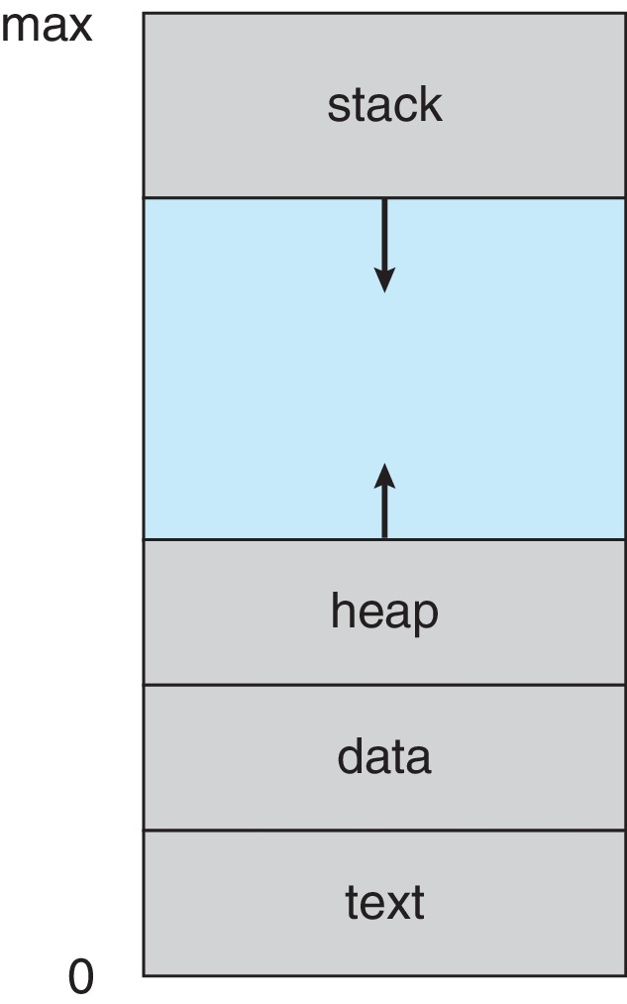
Process in Memory

Slide 8
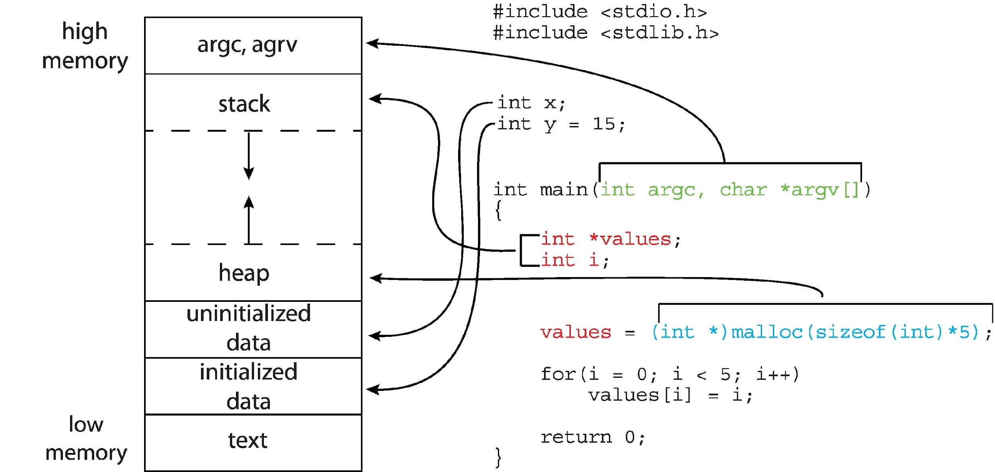
Memory Layout of a C Program

Slide 9
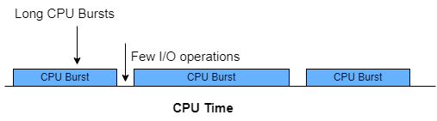
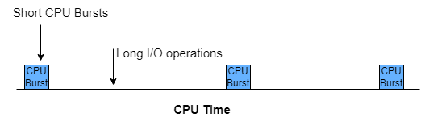
CPU and I/O Bound Processes
Processes can be described as either:
CPU-bound process
I/O-bound process
(Spends more time in computations)
(Spends more time in I/O operations)

Slide 10
Process State
As a process executes, it changes state
New: The process is being created
Running: Instructions are being executed
Waiting: The process is waiting for some event to occur
Ready: The process is waiting to be assigned to a processor
Terminated: The process has finished execution

Slide 11
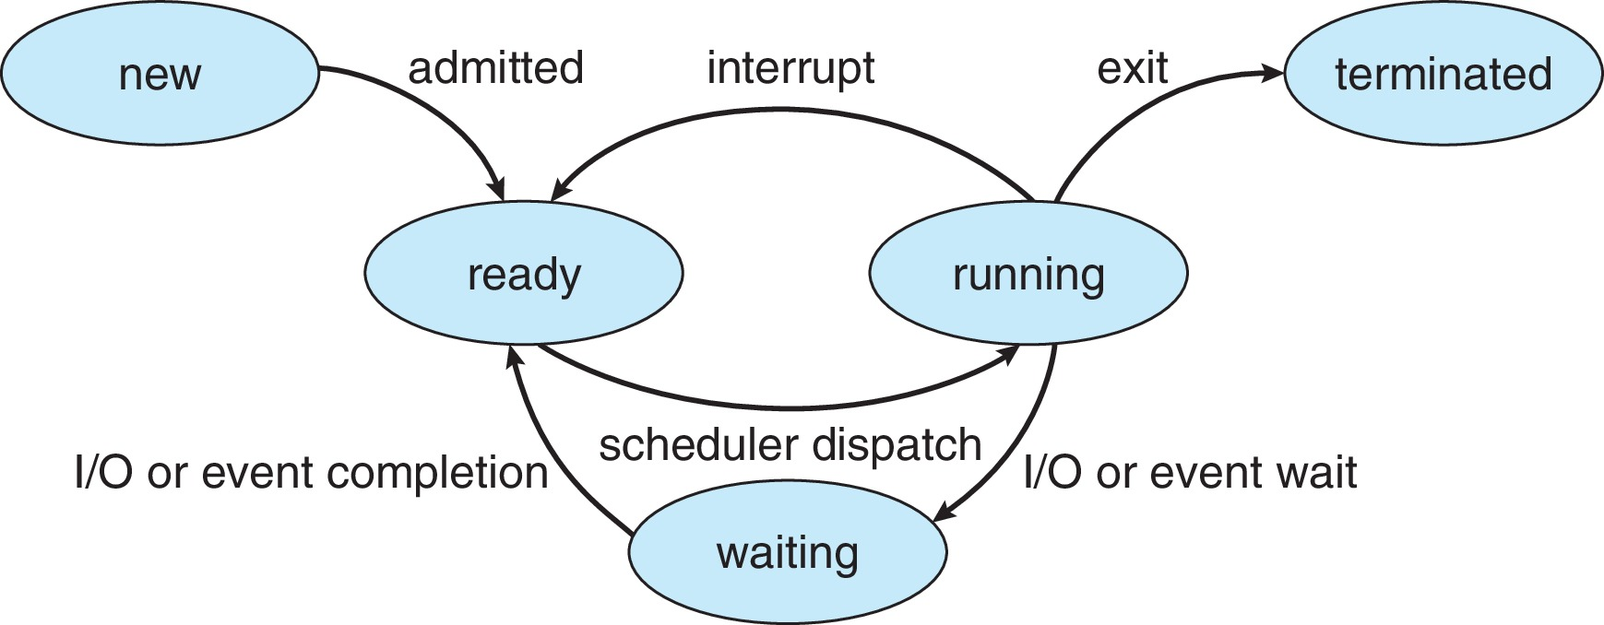
Diagram of Process State

Slide 12
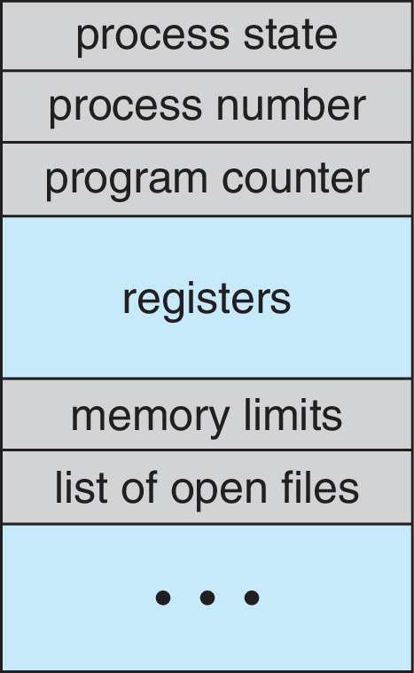
Process Control Block (PCB)
Information associated with each process(also called task control block)
Process state – running, waiting, etc.
Program counter – location of instruction to next execute
CPU registers – contents of all process-centric registers
CPU scheduling information- priorities, scheduling queue pointers
Memory-management information – memory allocated to the process
Accounting information – CPU used, clock time elapsed since start, time limits
I/O status information – I/O devices allocated to process, list of open files
PID, PPID
Per process file table

Slide 13
Threads
So far, process has a single thread of execution
Consider having multiple program counters per process
Multiple locations can execute at once
Multiple threads of control -> threads
Must then have storage for thread details, multiple program counters in PCB
Explore in detail in Chapter 4

Slide 14
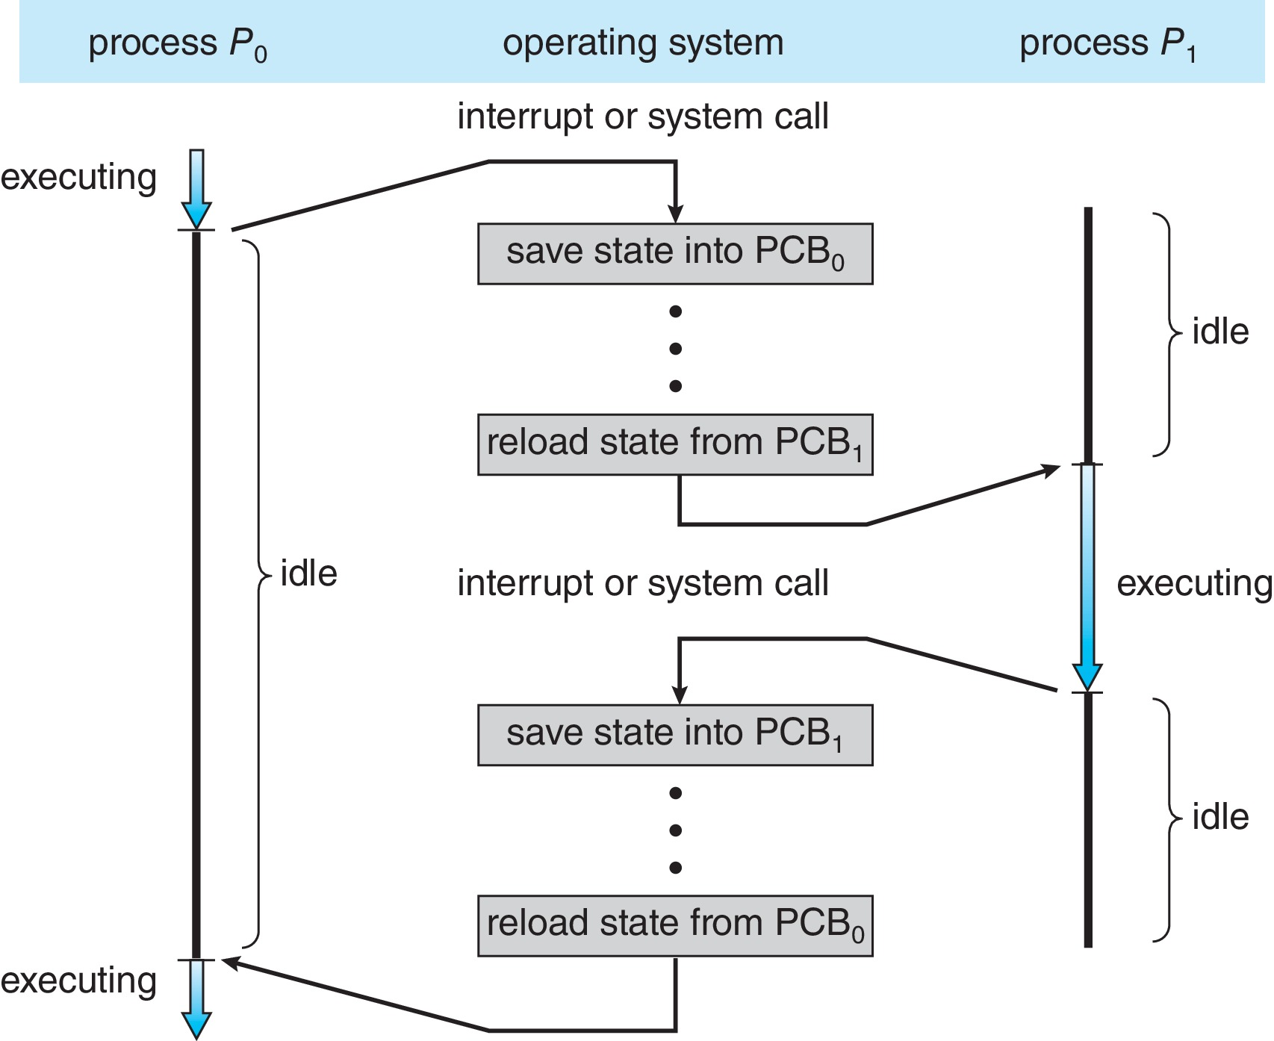
CPU Switch From Process to Process
A context switch occurs when the CPU switches from one process to another.

Slide 15
Context Switch
When CPU switches to another process, the system must save the state of the old process and load the saved state for the new process via a context switch (Dispatcher)
Context of a process represented in the PCB
Context-switch time is pure overhead; the system does no useful work while switching
The more complex the OS and the PCB 🡺 the longer the context switch
Time dependent on hardware support
Some hardware provides multiple sets of registers per CPU 🡺 multiple contexts loaded at once

Slide 16
Process Scheduling
Process scheduler selects among available processes for next execution on CPU core
Goal -- Maximize CPU use, quickly switch processes onto CPU core
Maintains scheduling queues of processes
Job queue – set of all processes in the system
Ready queue – set of all processes residing in main memory, ready and waiting to execute
Wait queues – set of processes waiting for an event (i.e., I/O)
Processes migrate among the various queues
Reasons: Memory requirements of the process exceeds
Signal from OS, wait for I/O, wait for event

Slide 17
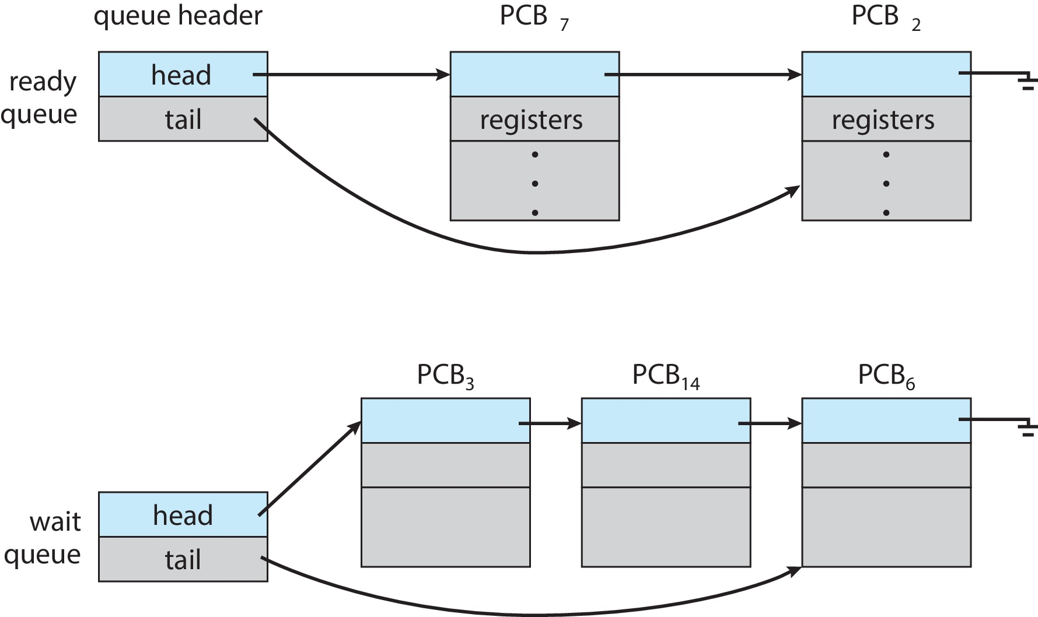
Ready and Wait Queues

Slide 18
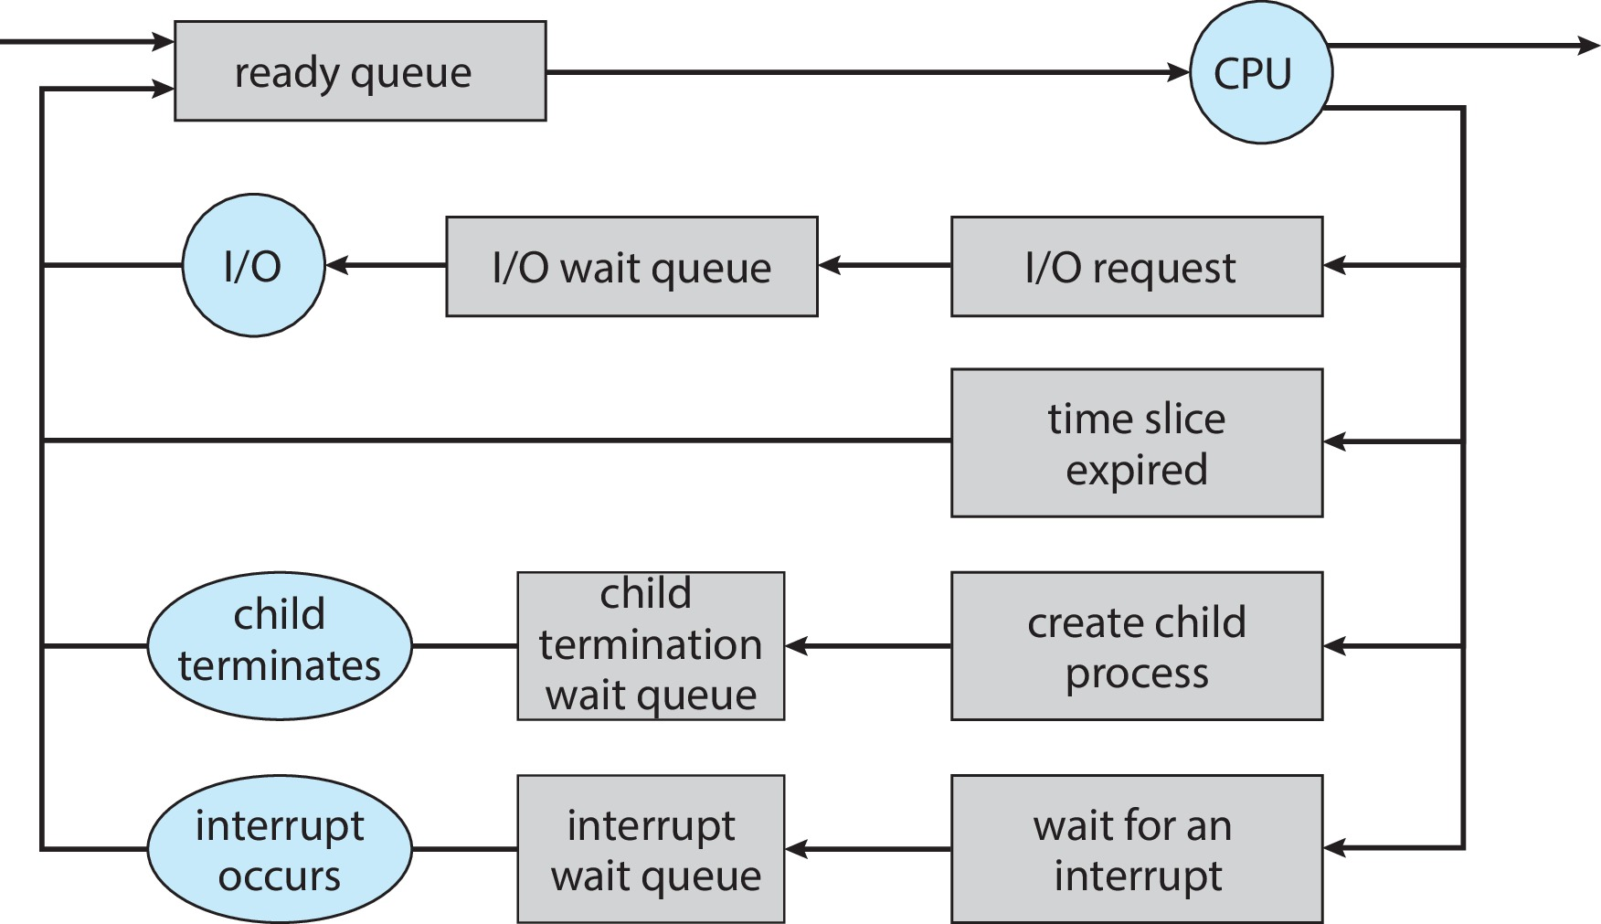
Representation of Process Scheduling

Slide 19
Schedulers
Short-term scheduler (or CPU scheduler) – selects which process should be executed next and allocates CPU
Sometimes the only scheduler in a system
Invoked frequently ⇒ (must be fast)
Invokes context switching- Highly time crucial
Long-term scheduler (or job scheduler) – selects which processes should be brought into the ready queue
Invoked infrequently ⇒ (may be slow)
Controls the degree of multiprogramming
Long-term scheduler strives for good process mix
Medium Term Schedulers (or Swapping scheduler)
Process from main memory to disk temporarily (swap space)
Medium speed for swap in and swap out

Slide 20
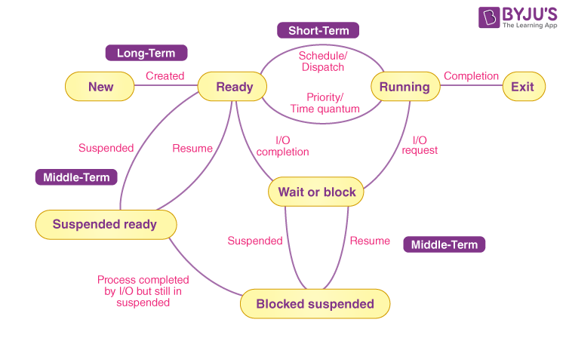
Schedulers

Slide 21
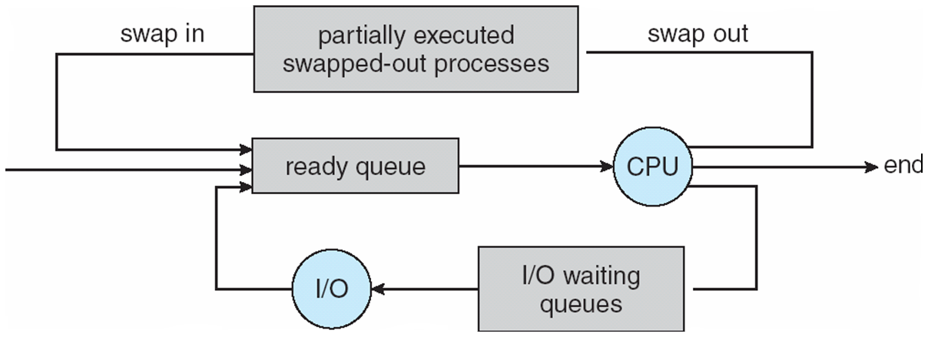
Addition of Medium Term Scheduling
Medium-term scheduler can be added if degree of multiple programming needs to decrease
Remove process from memory, store on disk, bring back in from disk to continue execution: swapping

Slide 22
Operations on Processes
System must provide mechanisms for:
Process creation
Process termination

Slide 23
Process Creation
Parent process create children processes, which, in turn create other processes, forming a tree of processes
Generally, process identified and managed via a process identifier (pid)
Resource sharing options
Parent and children share all resources
Children share subset of parent’s resources
Parent and child share no resources
Execution options
Parent and children execute concurrently
Parent waits until children terminate

Slide 24
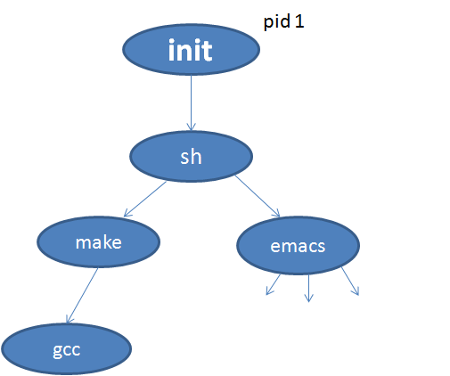
Process Tree on UNIX
Root
Page daemon
Swapper

Slide 25
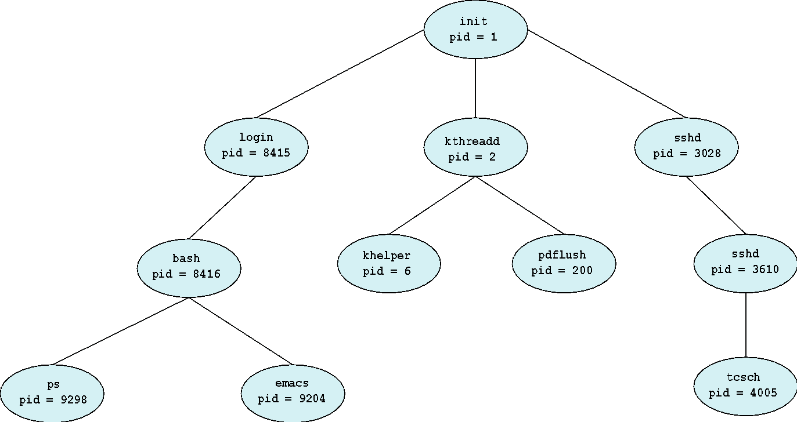
A Tree of Processes in Linux

Slide 26
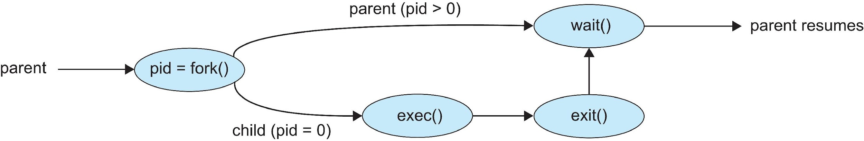
Process Creation (Cont.)
Address space
Child duplicate of parent
Child has a program loaded into it
UNIX examples
fork() system call creates new process
exec() system call used after a fork() to replace the process’ memory space with a new program
Parent process calls wait()waiting for the child to terminate

Slide 27
Process creation
The return code for fork is 0 for the child process and the process identifier is returned to the parent process.
On success, both the processes continue execution at the instruction after the fork
The child process may be assigned a task and the parent can be made to wait for the child
On failure, -1 is returned to the parent process and errno (kernel variable) is set to the appropriate value to indicate the reason of failure and no child is created
Errno is an important information for the parent to understand the issue/reason with child creation i.e.
Number of child is exceeded from predefined number
Child exceeds the resources
Systems child process limit is reached
Swap space or memory does not has space

Slide 28
Fork () inherits
Sample:
#include <sys/types.h>
#include<unistd.h>
pid_t fork();
The child process inherits the following attributes from the parent.
Environment
Open file descriptor table
Signal handling settings
Current working directory
Root directory
File mode creation mask (unmask)
Nice value (priority)
The child differs from the parent.
Different child ID (PID)
Different parent ID (PPID)
Child has its own copy of parents file descriptors
Parent pid=1234
Child pid=0
Kernel

Slide 29
wait ()
The wait system call suspends the calling process until one of its immediate children terminates.
Wait returns prematurely if a signal is received from the system,
If all the child process stopped or terminated prior to the call on wait, return is immediate.
If the wait call is successful, the process ID of the terminating child is returned
If the parent terminates, all the child processes are assigned a new parent the init (granddaddy of all process) process. Thus the children still have a parent to return their status and execution statistics.

Slide 30
Process Termination
Process executes last statement and then asks the operating system to delete it using the exit() system call.
Returns status data from child to parent (via wait())
The process of parent process deallocating a child process resources is called reaping
A child whose parent doesn't reap it is known as zombie process
Process’ resources are deallocated by operating system
Parent may terminate the execution of children processes using the abort() system call.
Some reasons for child termination:
Child has exceeded allocated resources
Task assigned to child is no longer required
The parent is exiting, and the operating systems does not allow a child to continue if its parent terminates

Slide 31
Process Termination (Reasons)
Some operating systems do not allow child to exists if its parent has terminated. If a process terminates, then all its children must also be terminated.
Cascading termination. All children, grandchildren, etc., are terminated.
The termination is initiated by the operating system.
The parent process may wait for termination of a child process by using the wait()system call. The call returns status information and the pid of the terminated process
pid = wait(&status);
If no parent waiting (did not invoke wait()) process is a zombie or defunct a process that has completed execution but still has an entry in the process table as its parent process didn't invoke an wait() system call
If parent terminated without invoking wait(), process is an orphan i.e. a computer process whose parent process has finished or terminated, though it (child process) remains running itself.

Slide 32
exec ()
The exec system call is used after the fork system call by one of the two processes to replace the process memory space with a new executable program.
The new process image is constructed from the other executable file (e.g. from /bin folder)
There is no return from a successful exec() system call i.e. the process may not go back to its original memory image
The calling process image is overlaid by the new process image but the PID remains the same
#include <unistd.h>
int execlp(const char *filepath, const char *arg0,….. const char *argn, (char *), () );
execlp (“/bin/ls”,“ls”, “-l”, NULL)

Slide 33
exec ()
Parent Parent Parent
P
P
P
fork() execlp “ls”
P
P
ls
Child Child Child

Slide 34
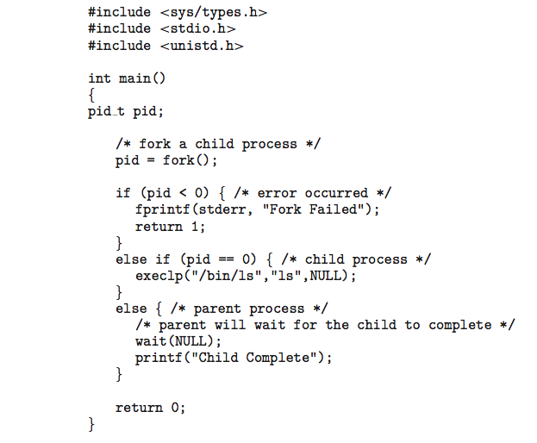
C Program Forking Separate Process
exit (1);
exit (0);
exit (0);

Slide 35
Interprocess Communication
Processes within a system may be independent or cooperating
Independent process does not affect or get affected by another process
Cooperating process can affect or be affected by other processes, including sharing data
Reasons/advantages for cooperating processes:
Information sharing
Computation speedup
Modularity
Convenience
Cooperating processes need interprocess communication (IPC)
Two models of IPC
Shared memory (under the control of users-PC scenario)
Message passing (under the control of OS-Pipes)

Slide 36
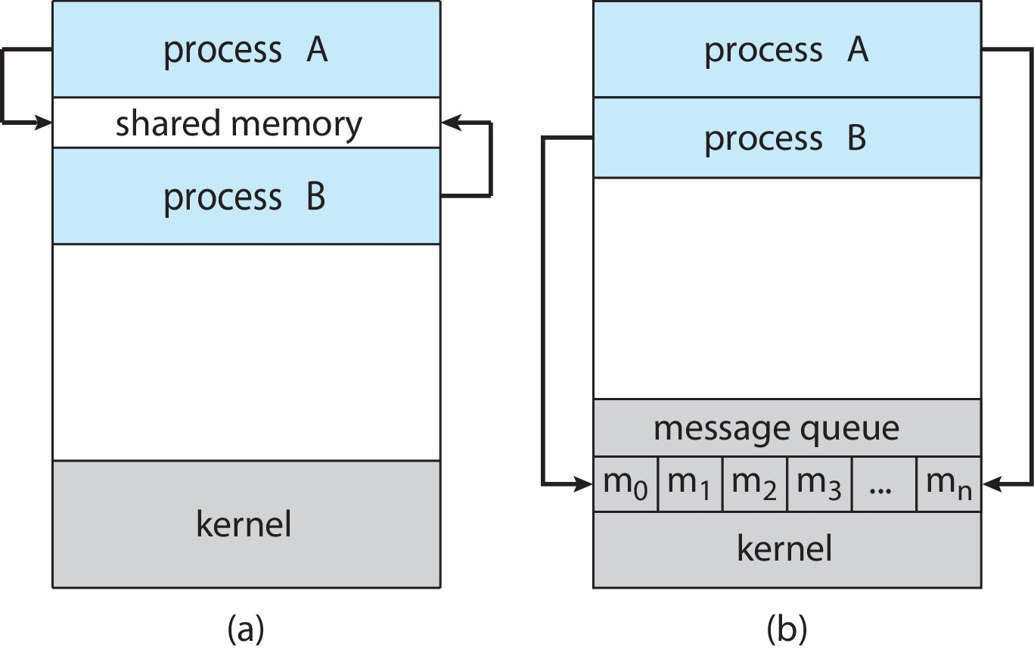
Communications Models
(a) Shared memory. (b) Message passing.

Slide 37
Producer-Consumer Problem
Paradigm for cooperating processes:
producer process produces information that is consumed by a consumer process
Two variations:
unbounded-buffer places no practical limit on the size of the buffer:
Producer never waits
Consumer waits if there is no buffer to consume
bounded-buffer assumes that there is a fixed buffer size
Producer must wait if all buffers are full
Consumer waits if there is no buffer to consume

Slide 38
Shared Memory Solution
An area of memory shared among the processes that wish to communicate
The communication is under the control of the users processes not the operating system.
Major issues is to provide mechanism that will allow the user processes to synchronize their actions when they access shared memory.
Synchronization is discussed in great details in Chapters 6 & 7.

Slide 39
Bounded-Buffer – Shared-Memory Solution
Shared data
#define BUFFER_SIZE 10
typedef struct {
. . .
} item;
item buffer[BUFFER_SIZE];
int in = 0;
int out = 0;
Solution presented in next slides is correct, but can only use BUFFER_SIZE-1 items; that is: 9 items

Slide 40

Bounded-Buffer (Cont.)

Slide 41
Producer Process – Shared Memory
item next_produced;
while (true) {
/* produce an item in next produced */
while (((in + 1) % BUFFER_SIZE) == out)
; /* do nothing */
buffer[in] = next_produced;
in = (in + 1) % BUFFER_SIZE;
}

Slide 42
Consumer Process – Shared Memory
item next_consumed;
while (true) { while (in == out)
; /* do nothing */ next_consumed = buffer[out];
out = (out + 1) % BUFFER_SIZE;
/* consume the item in next consumed */
}

Slide 43
What about Filling all the Buffers?
Suppose that we wanted to provide a solution to the consumer-producer problem that fills all the buffers.
We can do so by having an integer counter that keeps track of the number of full buffers.
Initially, counter is set to 0.
The integer counter is incremented by the producer after it produces a new buffer.
The integer counter is and is decremented by the consumer after it consumes a buffer.

Slide 44
Producer
while (true) { /* produce an item in next produced */
while (counter == BUFFER_SIZE)
; /* do nothing */
buffer[in] = next_produced;
in = (in + 1) % BUFFER_SIZE;
counter++;
}

Slide 45
Consumer
while (true) {
while (counter == 0)
; /* do nothing */
next_consumed = buffer[out];
out = (out + 1) % BUFFER_SIZE;
counter--;
/* consume the item in next consumed */
}

Slide 46
Race Condition
counter++ could be implemented as register1 = counter register1 = register1 + 1 counter = register1
counter-- could be implemented as register2 = counter register2 = register2 - 1 counter = register2
Consider this execution interleaving with “count = 5” initially:
S0: producer execute register1 = counter {register1 = 5} S1: producer execute register1 = register1 + 1 {register1 = 6} S2: consumer execute register2 = counter {register2 = 5} S3: consumer execute register2 = register2 – 1 {register2 = 4} S4: producer execute counter = register1 {counter = 6 } S5: consumer execute counter = register2 {counter = 4}

Slide 47
Race Condition (Cont.)
Question – why was there no race condition in the first solution (where at most N – 1) buffers can be filled?
More in Chapter 6.

Slide 48
IPC – Message Passing
Processes communicate with each other without resorting to shared variables
IPC facility provides two operations:
send(message)
receive(message)
The message size is either fixed or variable

Slide 49
Message Passing (Cont.)
If processes P and Q wish to communicate, they need to:
Establish a communication link between them
Exchange messages via send/receive
Implementation issues:
How are links established?
Can a link be associated with more than two processes?
How many links can there be between every pair of communicating processes?
What is the capacity of a link?
Is the size of a message that the link can accommodate fixed or variable?
Is a link unidirectional or bi-directional?

Slide 50
Implementation of Communication Link
Physical:
Shared memory
Hardware bus
Network
Logical:
Direct or indirect
Synchronous or asynchronous
Automatic or explicit buffering

Slide 51
Direct Communication
Processes must name each other explicitly:
send (P, message) – send a message to process P
receive(Q, message) – receive a message from process Q
Properties of communication link
Links are established automatically
A link is associated with exactly one pair of communicating processes
Between each pair there exists exactly one link
The link may be unidirectional, but is usually bi-directional

Slide 52
Indirect Communication
Messages are directed and received from mailboxes (also referred to as ports)
Each mailbox has a unique id
Processes can communicate only if they share a mailbox
Properties of communication link
Link established only if processes share a common mailbox
A link may be associated with many processes
Each pair of processes may share several communication links
Link may be unidirectional or bi-directional

Slide 53
Indirect Communication (Cont.)
Operations
Create a new mailbox (port)
Send and receive messages through mailbox
Delete a mailbox
Primitives are defined as:
Send(A, message) – send a message to mailbox A
receive(A, message) – receive a message from mailbox A

Slide 54
Synchronization
Message passing may be either blocking or non-blocking
Blocking is considered synchronous
Blocking send -- the sender is blocked until the message is received
Blocking receive -- the receiver is blocked until a message is available
Non-blocking is considered asynchronous
Non-blocking send -- the sender sends the message and continue
Non-blocking receive -- the receiver receives:
A valid message, or
Null message
Different combinations possible
If both send and receive are blocking, we have a rendezvous

Slide 55
Producer-Consumer: Message Passing
Producer
message next_produced; while (true) { /* produce an item in next_produced */
send(next_produced);
}
Consumer
message next_consumed; while (true) { receive(next_consumed) /* consume the item in next_consumed */ }

Slide 56
Buffering
Queue of messages attached to the link.
Implemented in one of three ways
1. Zero capacity – no messages are queued on a link. Sender must wait for receiver (rendezvous)
2. Bounded capacity – finite length of n messages Sender must wait if link full
3. Unbounded capacity – infinite length Sender never waits

Slide 57
Pipes
Acts as a conduit allowing two processes to communicate
Issues:
Is communication unidirectional or bidirectional?
In the case of two-way communication, is it half or full-duplex?
Must there exist a relationship (i.e., parent-child) between the communicating processes?
Can the pipes be used over a network?
Ordinary pipes – cannot be accessed from outside the process that created it. Typically, a parent process creates a pipe and uses it to communicate with a child process that it created.
Named pipes – can be accessed without a parent-child relationship.

Slide 58
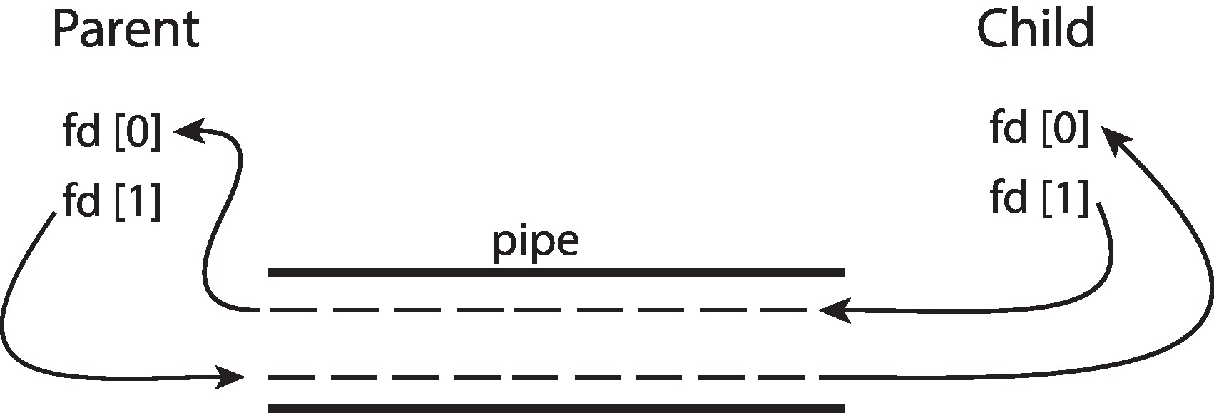
Ordinary Pipes
Ordinary Pipes allow communication in standard producer-consumer style
Producer writes to one end (the write-end of the pipe)
Consumer reads from the other end (the read-end of the pipe)
Ordinary pipes are therefore unidirectional
Require parent-child relationship between communicating processes
Windows calls these anonymous pipes

Slide 59
Named Pipes
Named Pipes are more powerful than ordinary pipes
Communication is bidirectional
No parent-child relationship is necessary between the communicating processes
Several processes can use the named pipe for communication
Provided on both UNIX and Windows systems

Slide 60
Communications in Client-Server Systems
Sockets
Remote Procedure Calls

Slide 61
Sockets
A socket is defined as an endpoint for communication
Concatenation of IP address and port
port is a number included at start of message packet to differentiate network services on a host
The socket 161.25.19.8:1625 refers to port 1625 on host 161.25.19.8
Communication consists between a pair of sockets
All ports below 1024 are well known, used for standard services
Special IP address 127.0.0.1 (loopback) to refer to system on which process is running

Slide 62
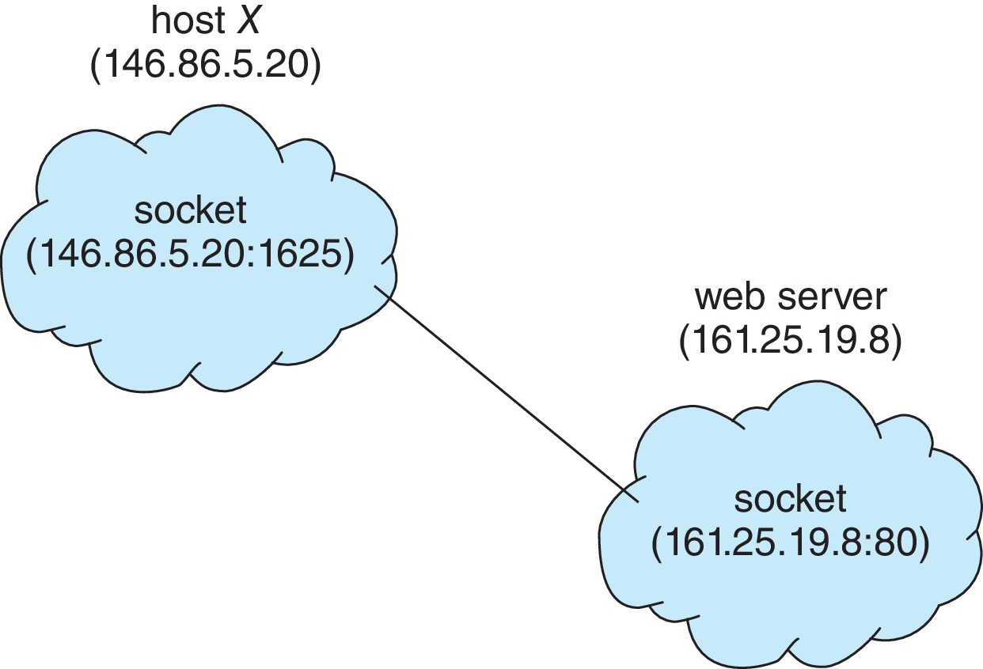
Socket Communication

Slide 63
Sockets in Java
Three types of sockets
Connection-oriented (TCP)
Connectionless (UDP)
MulticastSocket class– data can be sent to multiple recipients

Slide 64
Remote Procedure Calls
Remote procedure call (RPC) abstracts procedure calls between processes on networked systems
Again, uses ports for service differentiation
Stubs – client-side proxy for the actual procedure on the server
The client-side stub locates the server and marshalls the parameters
The server-side stub receives this message, unpacks the marshalled parameters, and performs the procedure on the server
On Windows, stub code compile from specification written in Microsoft Interface Definition Language (MIDL)

Slide 65
Remote Procedure Calls (Cont.)
Data representation handled via External Data Representation (XDL) format to account for different architectures
Big-endian and little-endian
Remote communication has more failure scenarios than local
Messages can be delivered exactly once rather than at most once
OS typically provides a rendezvous (or matchmaker) service to connect client and server

Slide 66
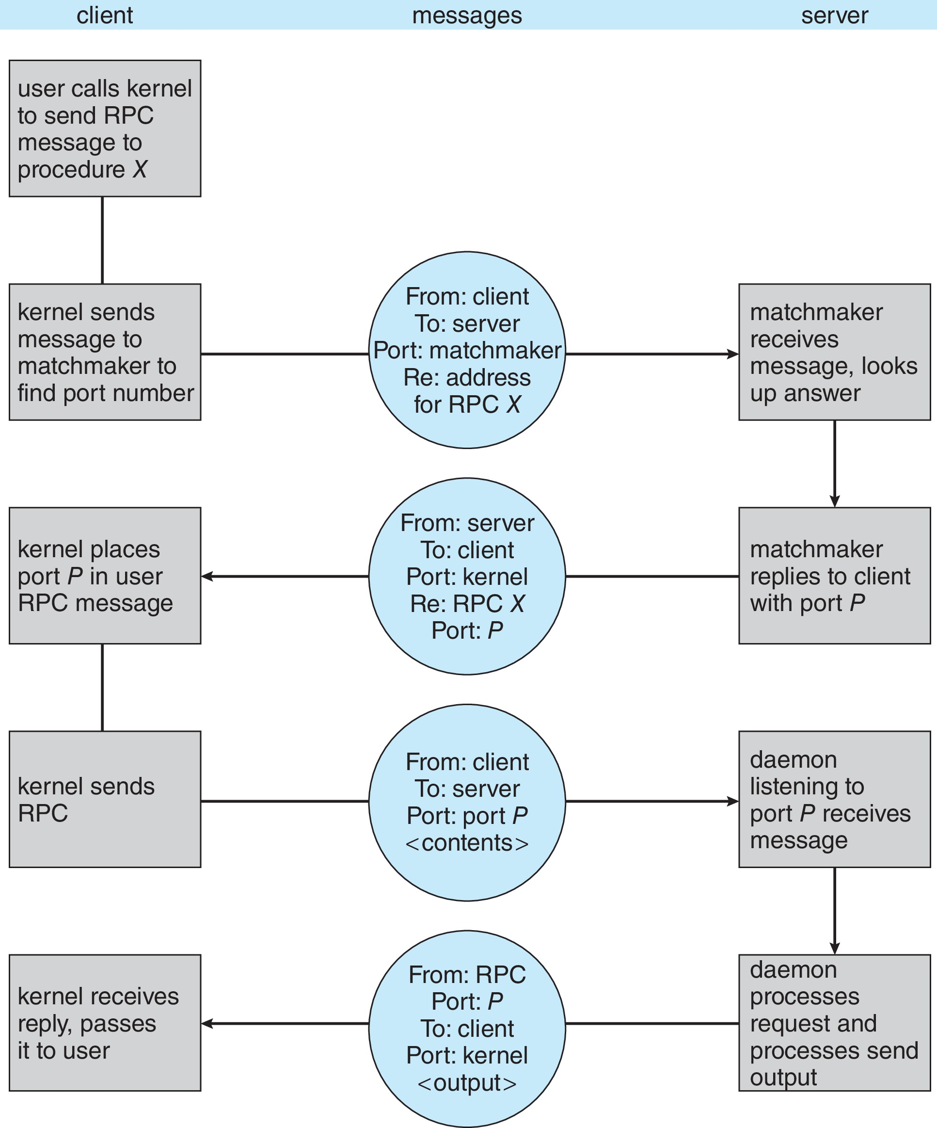
Execution of RPC

Slide 67
End of Chapter 3

